Slide 1

SmartEdge Access: AI-Based Offline Face Recognition Door Lock System Using
ESP32- CAM
Name : Appikonda Hima Bindu
Reg. no.323129512002

Slide 2

Project Overview
The Challenge
Traditional access methods like keys, RFID cards, and PIN pads are vulnerable to theft, loss, duplication, and pose hygiene concerns in high- traffic environments
The Solution
AI-powered offline face recognition system using ESP32-CAM and ESP- WHO library that unlocks doors securely upon successful facial identification
Key Benefits
Complete offline operation ensures enhanced privacy protection, ultra- low latency response, and superior power efficiency compared to cloud- based alternatives

Slide 3
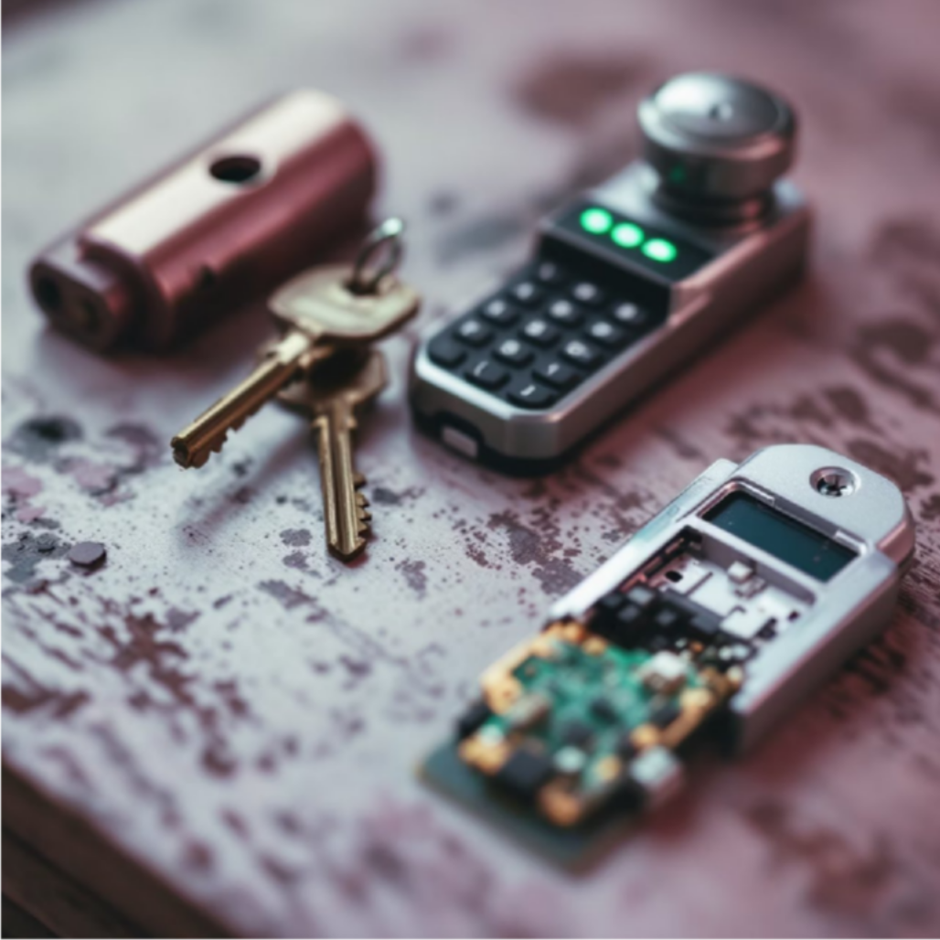
Why Face Recognition for Access Control?
Traditional Method Vulnerabilities
Hygiene & Convenience
Keys can be duplicated or stolen, RFID cards are susceptible to cloning and interception, while PIN pads suffer from shoulder surfing and brute-force attacks
Touchless operation eliminates hygiene concerns in public spaces whilst providing seamless user experience without physical tokens
Privacy-First Design
Fully offline processing addresses privacy concerns of cloud-based systems while maintaining fast response times and reliability

Slide 4
Literature Survey: Evolution of Access Control
Mechanical Systems
Traditional keys vulnerable to lock picking and unauthorised duplication, providing minimal security
for modern applications
1
2
Electronic Access
RFID and PIN systems improved convenience but introduced new vulnerabilities like cloning, interception, and brute-force attacks
Biometric Revolution
Fingerprint, iris, and face recognition offered higher security but faced challenges with accuracy, environmental conditions, and privacy
3
4
Edge AI Era
CNN-powered face recognition with local processing delivers superior accuracy whilst ensuring privacy and low latency response

Slide 5
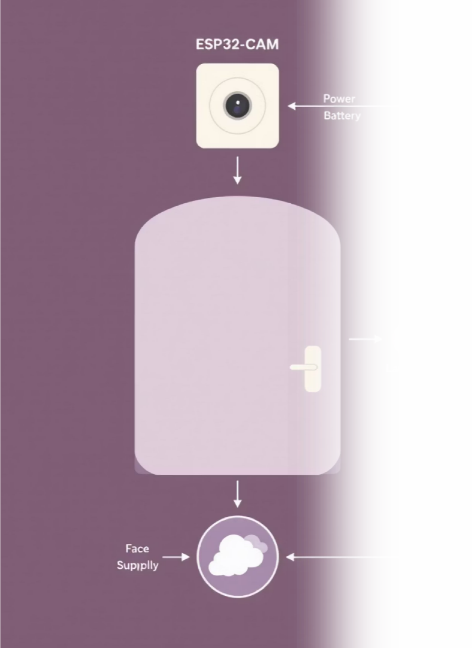
System Architecture
01
Image Capture & Processing
02
Local Template Matching
Extracted facial features are compared against locally stored authorised user templates in secure onboard database
ESP32-CAM captures facial images and performs real-time detection using integrated ESP-WHO library for accurate identification
03
Access Control Decision
Upon successful recognition within threshold parameters, relay module triggers electronic door lock to grant secure access

Slide 6

Hardware & Software Components
Hardware Specifications
Software Stack
ESP32-CAM Module
Development Environment
Dual-core MCU with OV2640 camera sensor and PSRAM for efficient image processing and storage
Arduino IDE with C++ programming and ESP-WHO library integration for face detection and recognition algorithms
Control & Power
Testing Framework
Relay module for door lock control with 5V DC power supply ensuring stable operation
Python simulation environment for workflow validation and system performance evaluation

Slide 7

Face Recognition Process Flow
Enrollment Phase
Multiple face images captured, feature vectors extracted using ESP-WHO, then averaged to create unique template stored locally
Detection & Analysis
Real-time face detection extracts features from live camera feed for comparison against enrolled user database
Access Decision
Template matching within threshold parameters triggers door unlock, maintaining privacy through offline processing

Slide 8
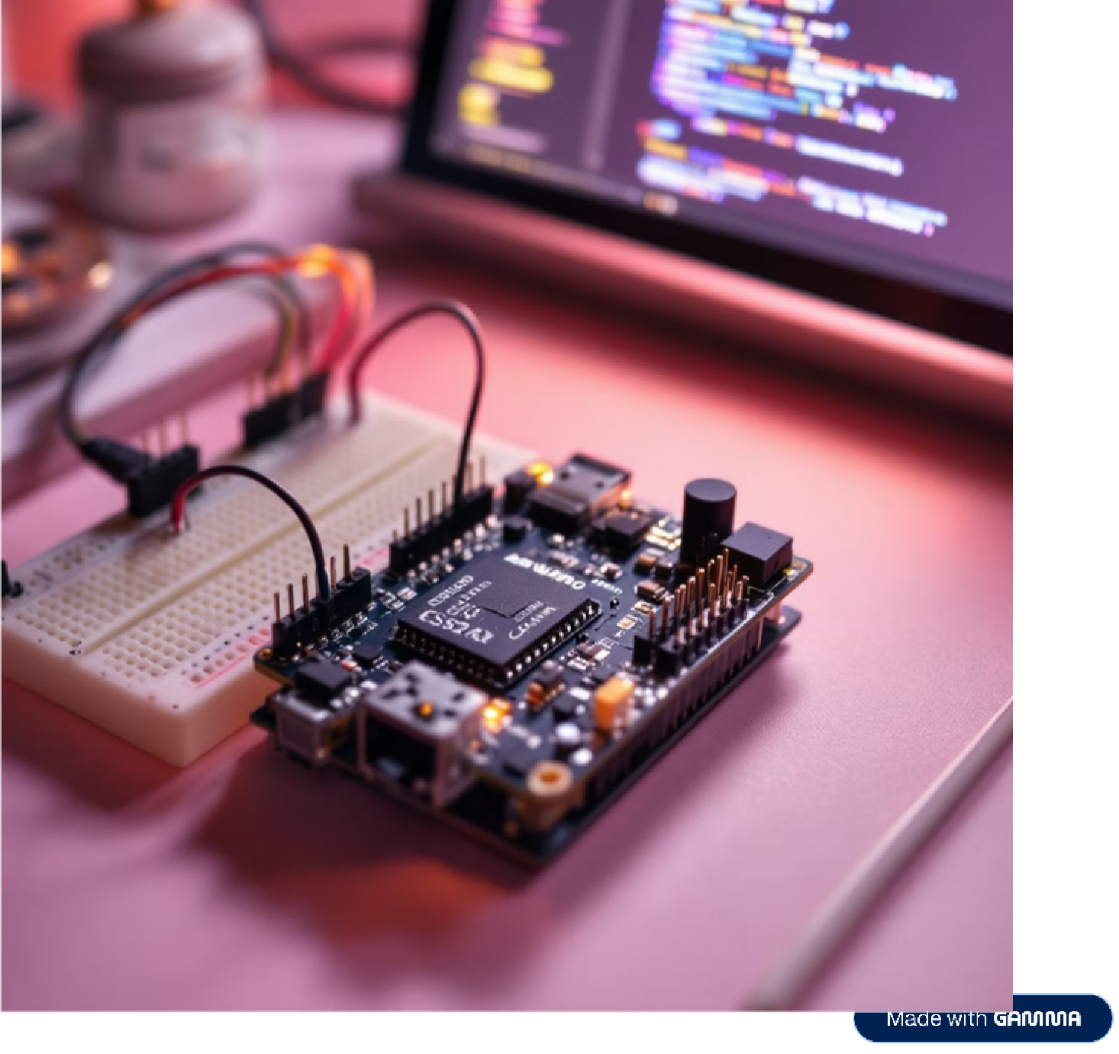
Implementation & Integration
Hardware Integration
Systematic connection of ESP32-CAM to relay module and electronic door lock with proper power distribution
Software Configuration
Camera initialisation and ESP-WHO library integration within Arduino IDE development environment
Testing Protocol
Python simulation validates complete workflow before deployment with comprehensive relay logic testing

Slide 9
Performance Results & Evaluation
>90%
Good Lighting Accuracy
~80%
Low Light Performance
Maintained accuracy in challenging lighting environments demonstrating system robustness
<2s
Response Time
Ultra-fast detection to unlock sequence ensuring seamless user experience
160mA
Peak Power Consumption
Efficient power usage suitable for battery-powered deployment scenarios
Excellent recognition performance under optimal illumination conditions with reliable user distinction

Slide 10

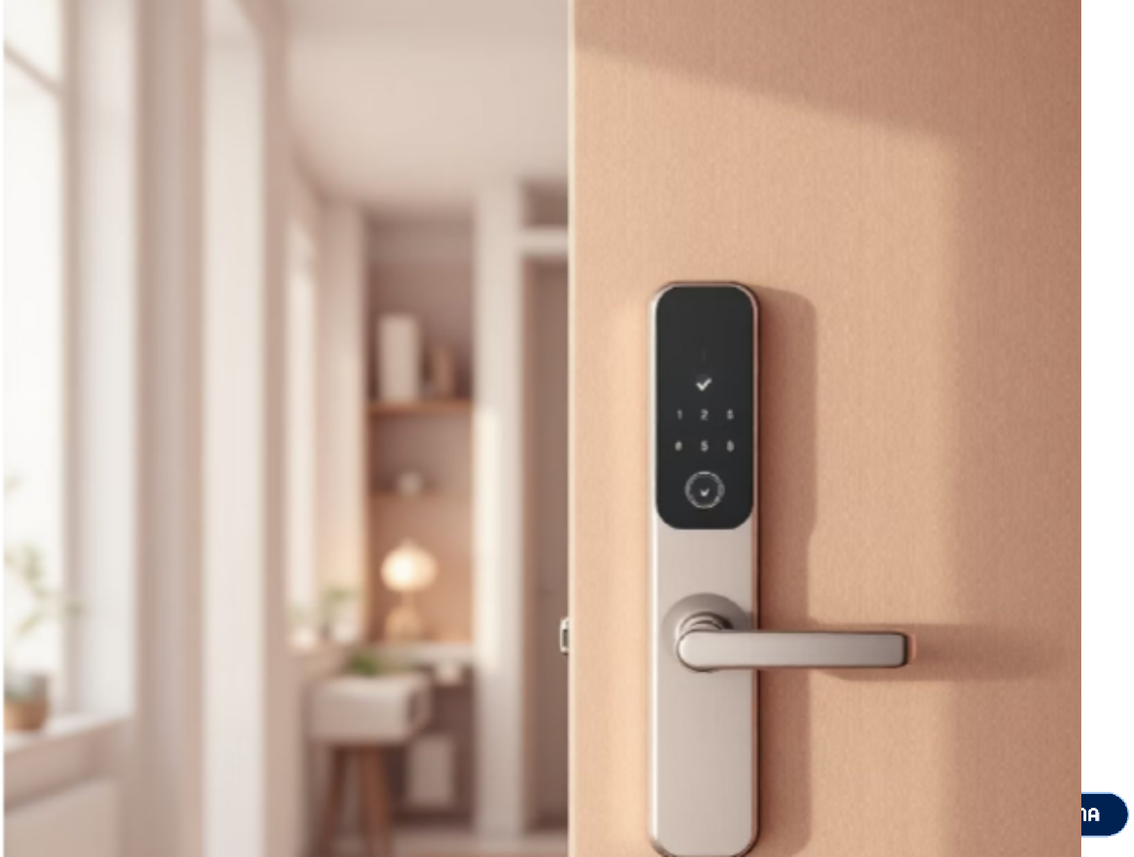

Future Enhancements & Conclusion
Planned Improvements
Project Success
Successfully demonstrated the power of edge AI in real-world security applications through cost-effective, privacy-preserving access control.
The system achieves fast, accurate results whilst providing a compelling alternative to cloud-based solutions, proving that sophisticated AI can operate efficiently on embedded platforms.
Enhanced Imaging
IR illumination for superior low-light performance and liveness detection to prevent spoofing attacks
Smart Integration
Mobile app for enrollment management and building system integration with expanded SD card storage

